Slide 1

Final Walkthrough
Mettu Sai Nishanth Praneeth Kumar Thummalapalli Varad Naik

Slide 2
New York Youth’s Drug Abuse
01.

Slide 3
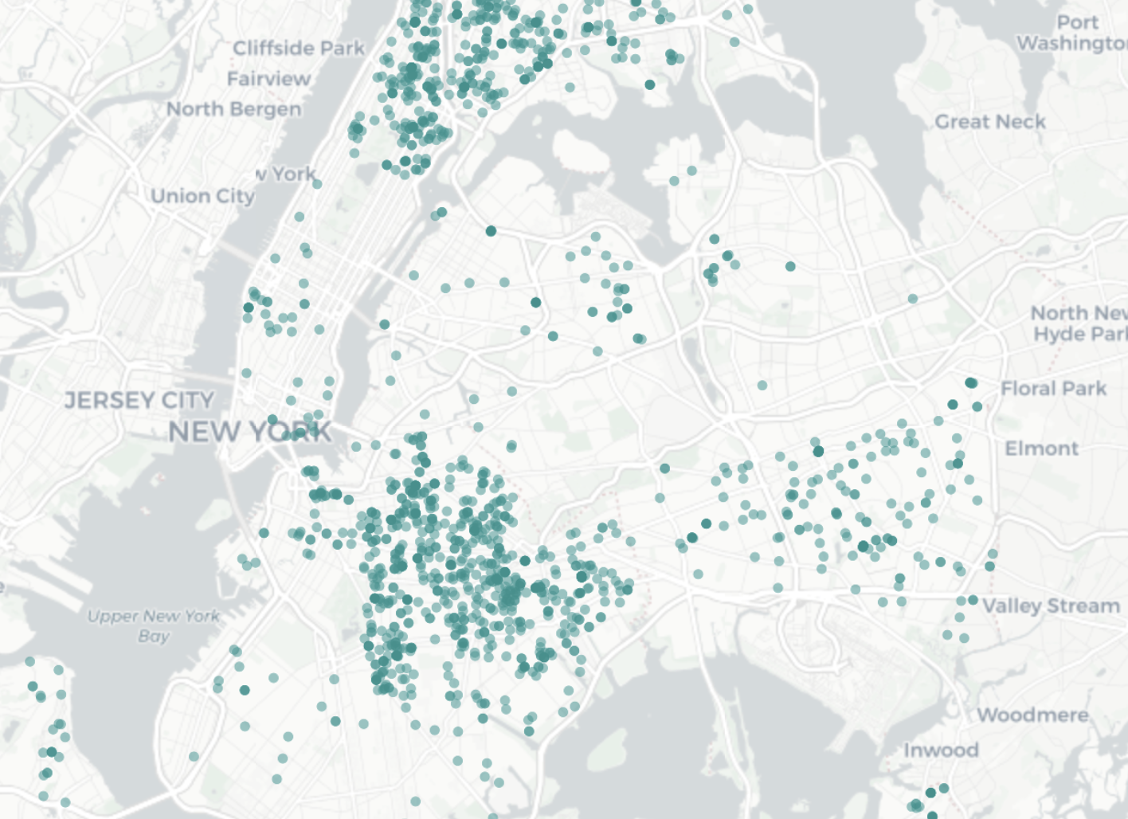
PROBLEM AND BACKGROUND
Addressing the escalating drug abuse problem among New York City's youth necessitates a comprehensive approach. By scrutinizing the social, mental, and financial states of the youth and referencing past drug abuse cases, we aim to pinpoint influential factors. Employing clustering analysis, a predictive model will assess the likelihood of a young person succumbing to drug abuse under specific conditions. Beyond current trends, our forecast model will estimate future cases, aiding in resource allocation.
Today, that trailblazing spirit makes NYU one of the most prominent and respected research universities in the world, featuring top-ranked academic programs and accepting fewer than one-in-five undergraduates.

Slide 4
DATA SOURCE & TARGET VARIABLES
Our Dataset is meticulously curated from research papers, websites including NYC Open Data, US Substance Abuse and Mental Health Data Archive, World Open Data, and NYC Bureau of Virtual Statistics.
https://opendata.cityofnewyork.us/
https://www.cdc.gov/nchs/
https://www.datafiles.samhsa.gov/
Through our models, we want to predict the Drug Abuse Incidence, Forecast the Growth of Incidents in New York and Cluster the Youth based on Socio-Economic, Health and Behavioural attributes to derive insights!

Slide 5
PROBLEM AND DATA COLLECTION CHALLENGES!
Data Collection Challenges
Diverse data sources, varying formats, and quality disparities demanded meticulous integration. Ethical considerations and analyzing research papers added complexity, requiring a careful approach to privacy regulations and a methodical process for distilling valuable insights while ensuring data accuracy.
General Challenges
Addressing stigma and reporting bias, staying abreast of dynamic substance abuse trends, fostering interdisciplinary collaboration, navigating policy variability, and managing resource constraints were overarching challenges in comprehensively understanding and addressing youth substance abuse in NYC.

Slide 6
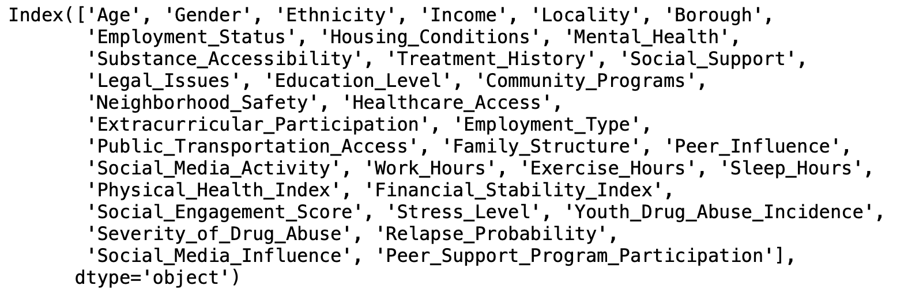
DATA DESCRIPTION
We have two datasets!
Dataset 1 : encompasses all the Socio-Economic & Health history data of the anonymous subjects. Dataset 2 : Contains the Geospatial data, which pin-points the places where Youth Drug Abuse was recorded.
It amalgamates socio-economic and behavioural attributes with incident-related details, featuring categorical, quantitative, geospatial, temporal, and qualitative variables.

Slide 7
DATA PRE-PROCESSING!
The pre-processing of this comprehensive dataset involves systematic sampling for representation, denoising, imputation and outlier removal via Isolation Forest, one-hot encoding of categorical variables, and Min-Max scaling of numerical features, with specific attention to 'Income’.
As a further step, we analysed various features using Principal Component Analysis and Feature Selection to reduce our data to 25 features.

Slide 8
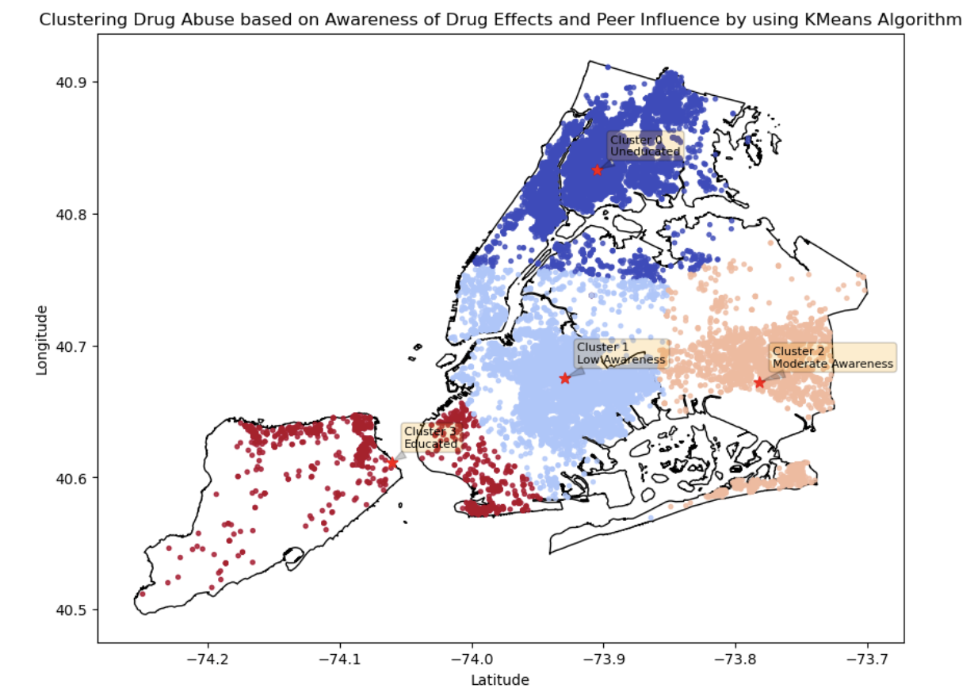
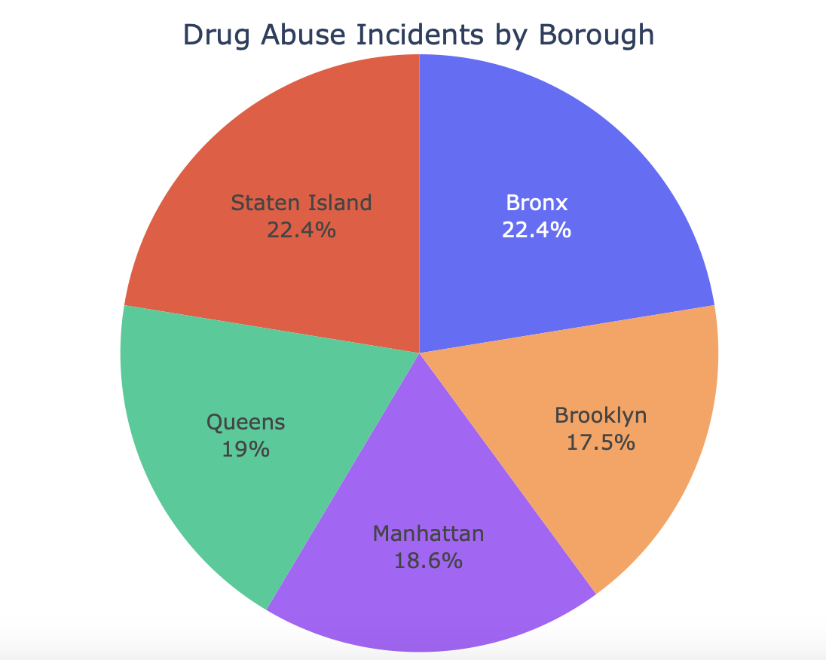
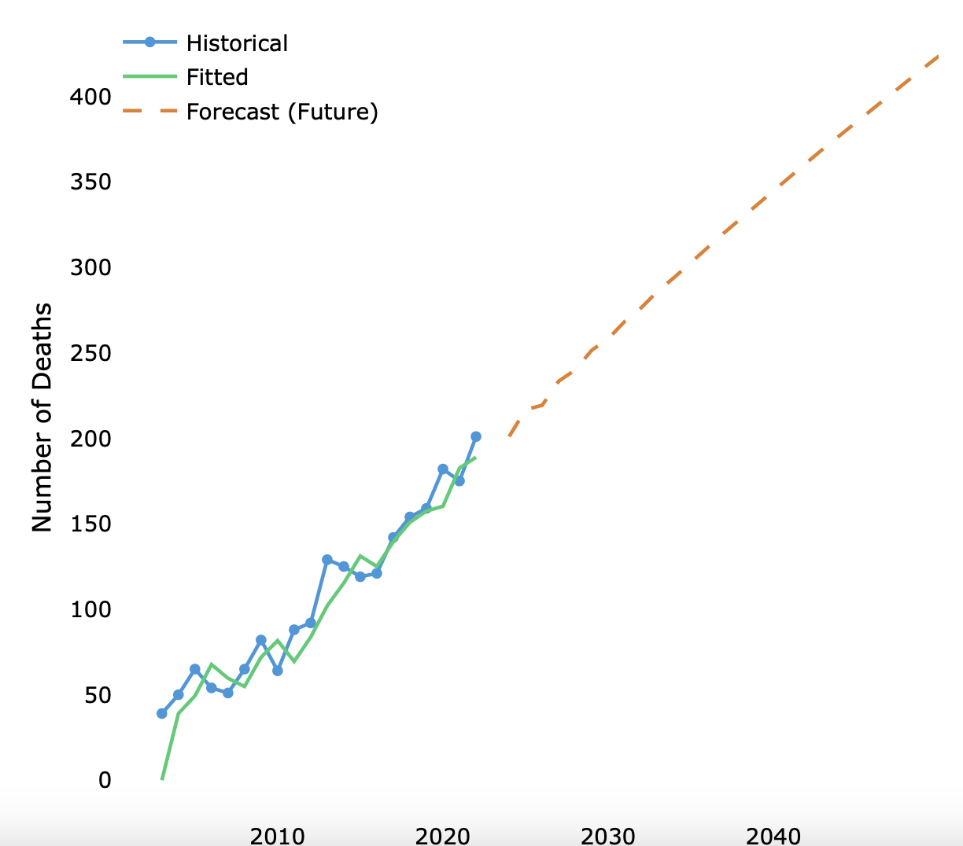
MODELLING TIME !
Logistic Regression
To find the Youth Drug Abuse Incidence
ARIMA Forecast
To forecast the growth of substance-abuse related cases in NYC
K-Means & Agglomerative Clustering
To cluster the victims based on socio-economic, health factors to derive common causes.

Slide 9
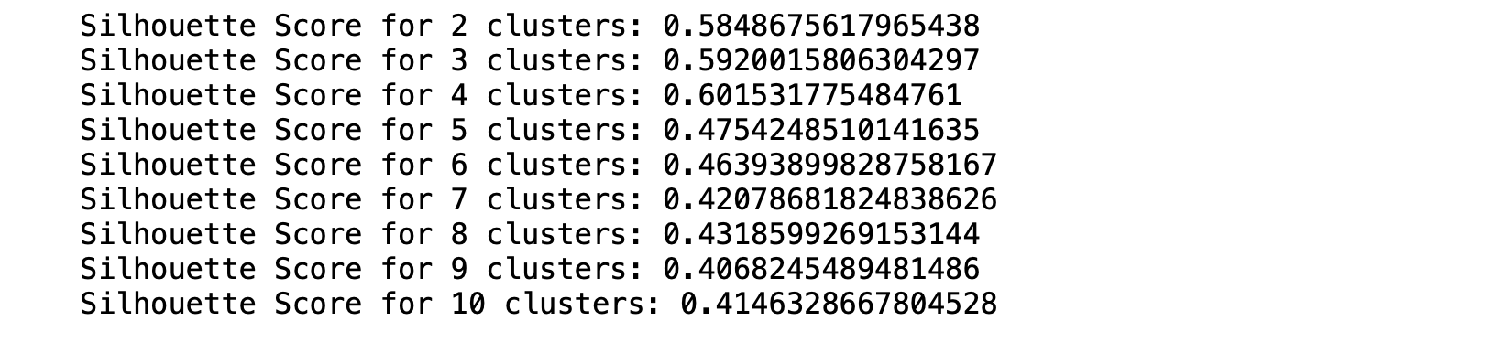
MODEL SELECTION…
Logistic Regression was chosen for its simplicity and effectiveness in binary classification. Cross-validation revealed its superior performance over alternatives like Random Forest and Support Vector Machine.
Accuracy : 0.91%, AUC Score : 0.92%
ARIMA was selected after comparing various forecasting methods like SARIMAX, ETS and Prophet considering its proven performance, simplicity, and interpretability.
MSE :244, MAE : 12, RMSE : 15
Agglomerative & K-Means Clustering were selected purely based on their performance and suitability
Silhouette Scores : 60 & 58

Slide 10
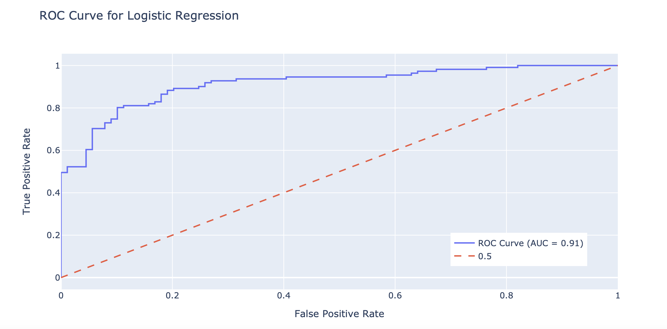
PERFORMANCE… (THE MONEY CHOP)
As stated earlier, our classification model performs exceptionally well on class 0 and it performs moderately well on class 1, thus averaging out to an overall AUC Score of 0.91. This seems encouraging to us considering the futuristic scope of applying Deep Learning!

Slide 11
“SAVE THE YOUTH TODAY TO BUILD A BETTER
TOMMORROW. ”

Slide 12
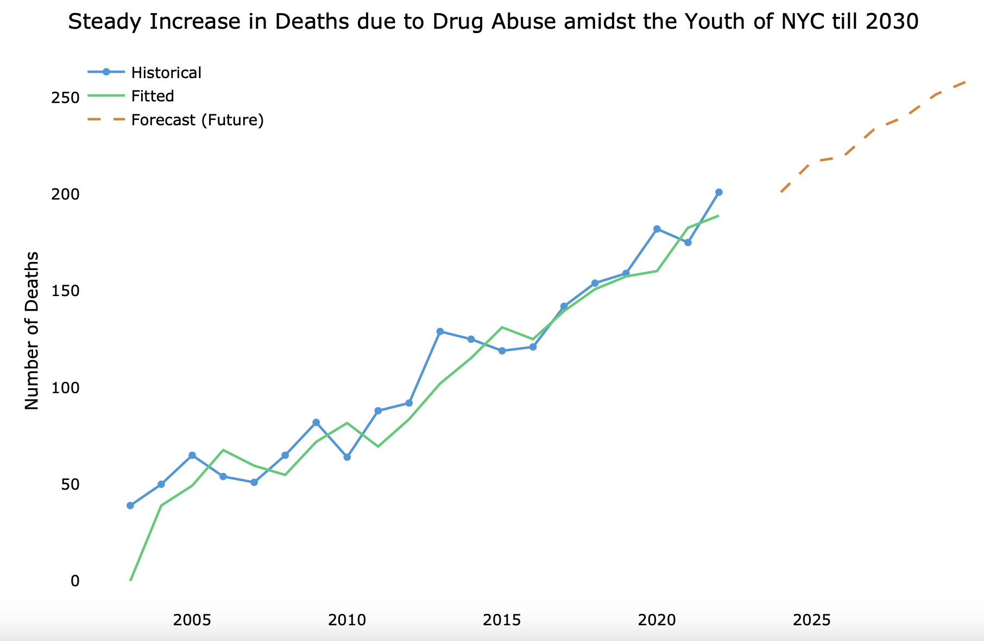
ASSUMPTIONS & LIMITATIONS!
We did not account for familial influences, genetic predispositions, or specific cultural factors that may impact drug abuse trends. The assumption of temporal stability is also made, assuming that the identified patterns.
God Forbid, not another Pandemic ☺ ! drug abuse remain relevant over time. Limitations emerge if external factors, like policy changes or socio-cultural shifts, significantly alter drug abuse dynamics.

Slide 13
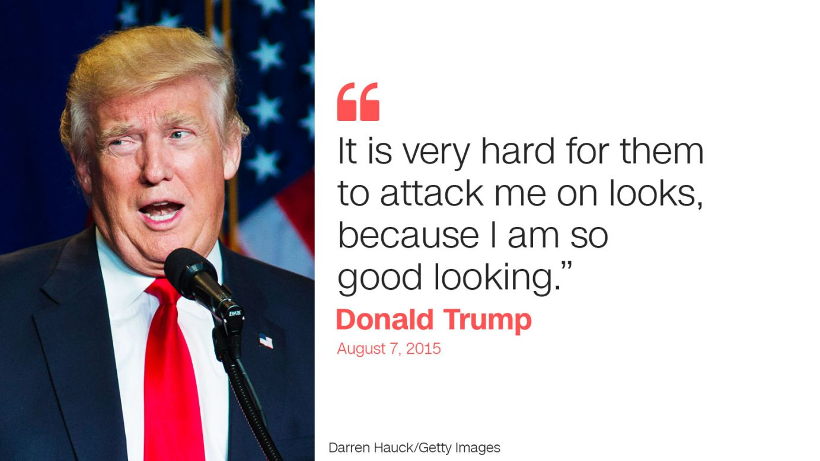

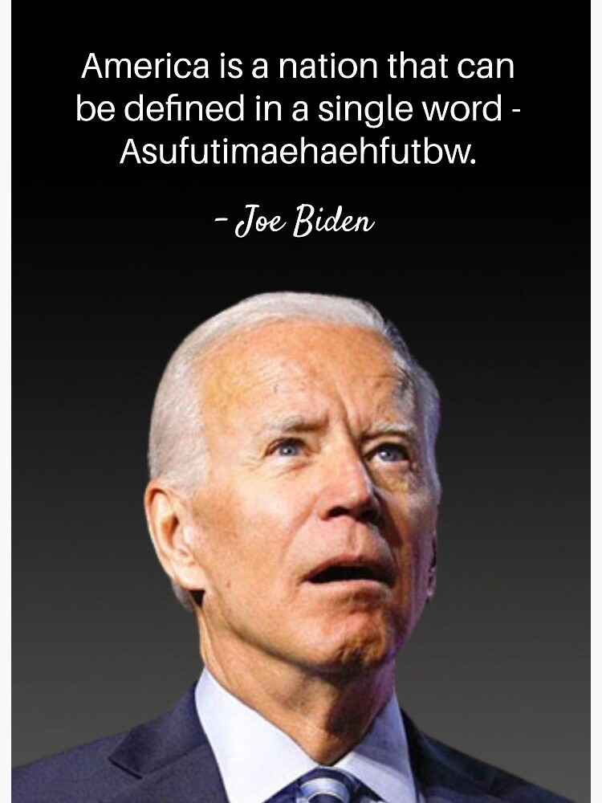
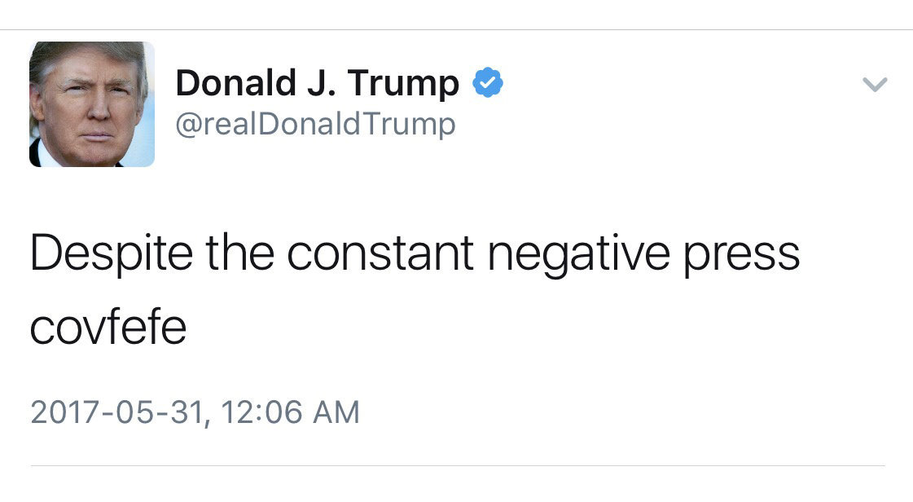
We also did not account for any political and decision-making shifts which would impact the drug abuse!
Well… are we are too optimistic to assume that the peace will last forever and everyone’s a nice bloke? ☺
abuse remain relevant over time. Limitations emerge if external factors, like policy changes or-cultural shifts, significantly alter drug abuse dynamics.
“SAVE THE YOUTH TODAY TO BUILD A BETTER

Slide 14
FUTURISTIC STEPS!
If more time were available or future efforts continued this project, refining the feature set by incorporating additional variables, such as familial history or community-level influences, could enhance model robustness. A deeper investigation into the spatial clustering results, potentially incorporating additional geographic information systems (GIS) data, could provide richer insights into the spatial distribution of drug abuse incidents.
changes or socio-cultural shifts, significantly alter drug abuse dynamics.

Slide 15
HOW CAN WE IMPROVE FURTHER!
Future efforts could refine the feature set by incorporating additional
variables (e.g., familial history, community-level influences) for
Improved model robustness.
alter drug abuse dynamics.
WHY NOT go deep into the data? WHY NOT apply deep learning!

Slide 16

HOW CAN WE IMPROVE FURTHER!

Slide 17
100%
INCREASE SINCE 2010
Today, in New York City, we have almost double the number of cases which were found in 2010.

Slide 18
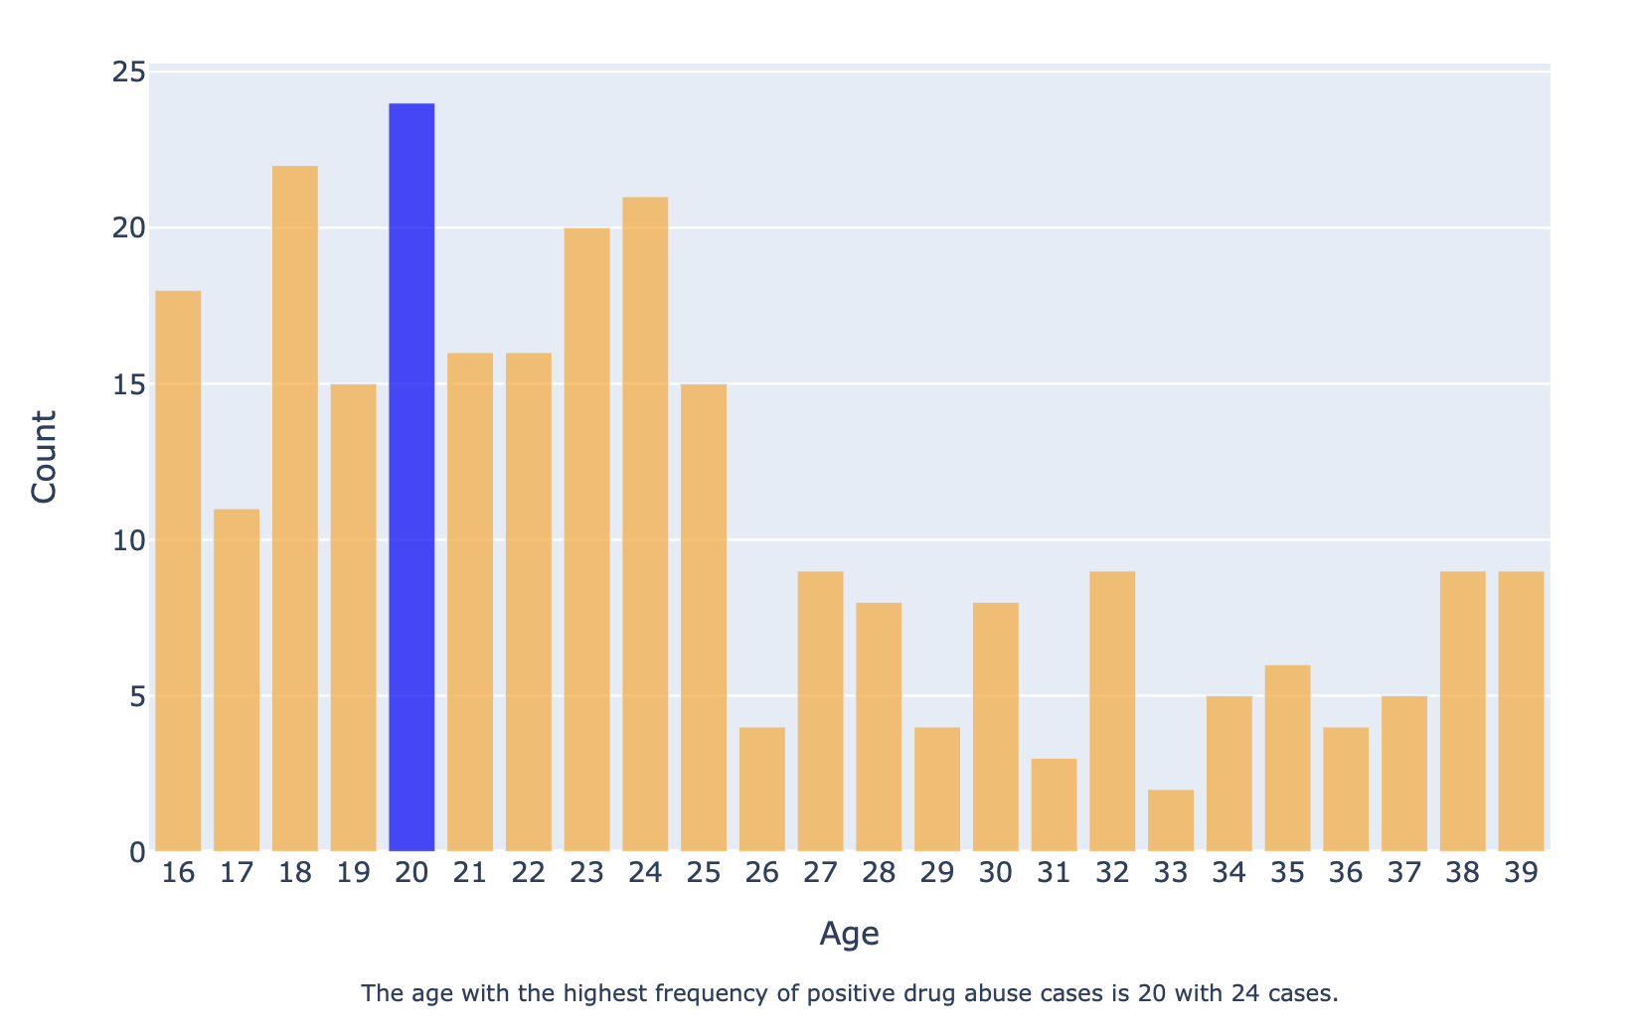
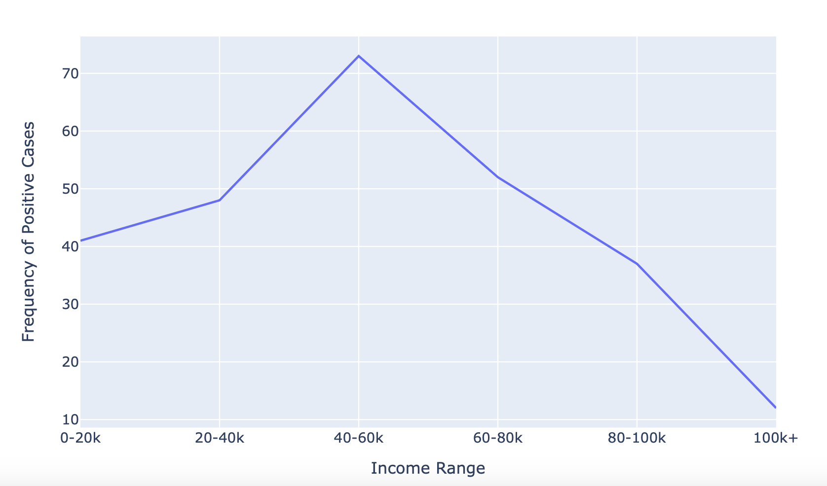
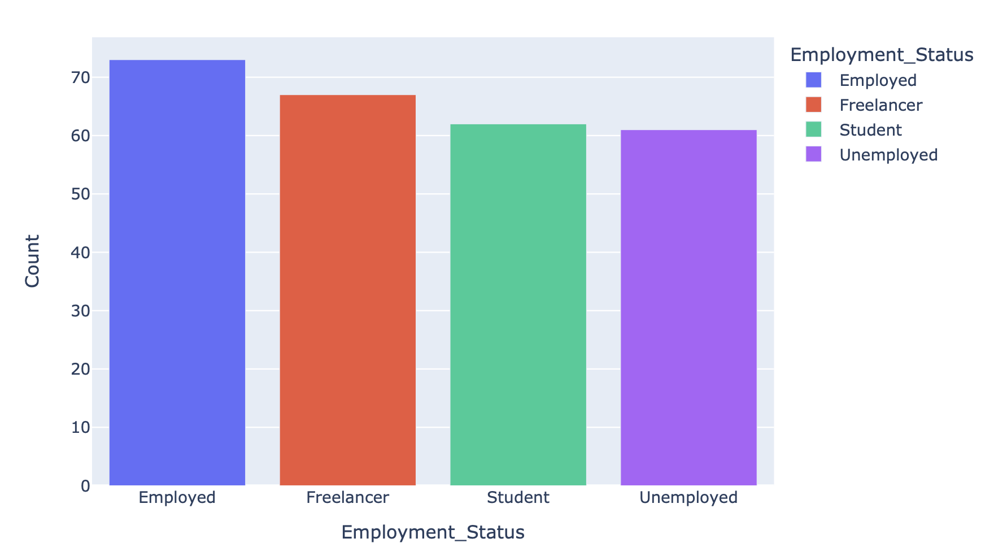
BUT WE ARE DATA SCIENTISTS <3 !

Slide 19
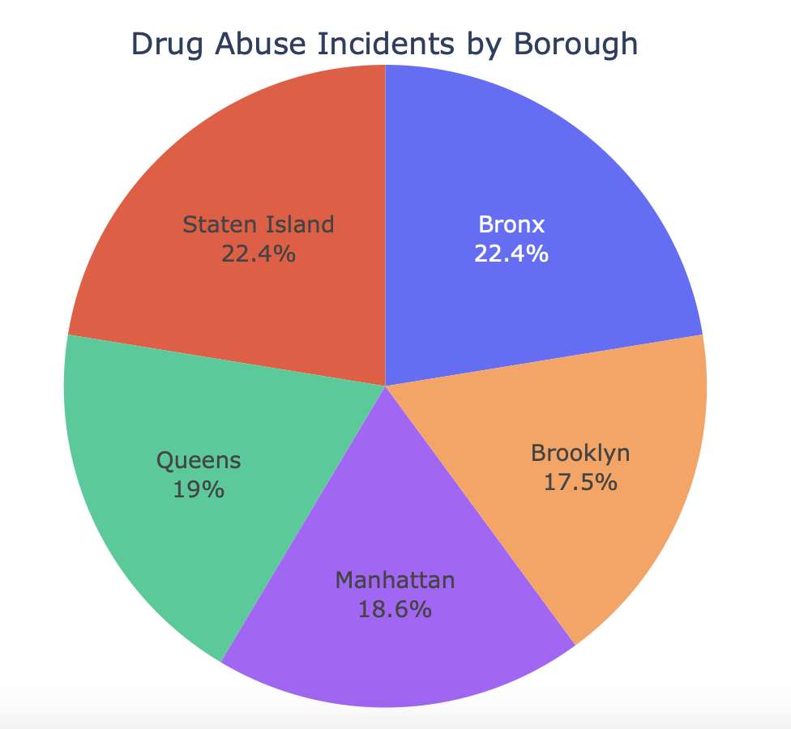
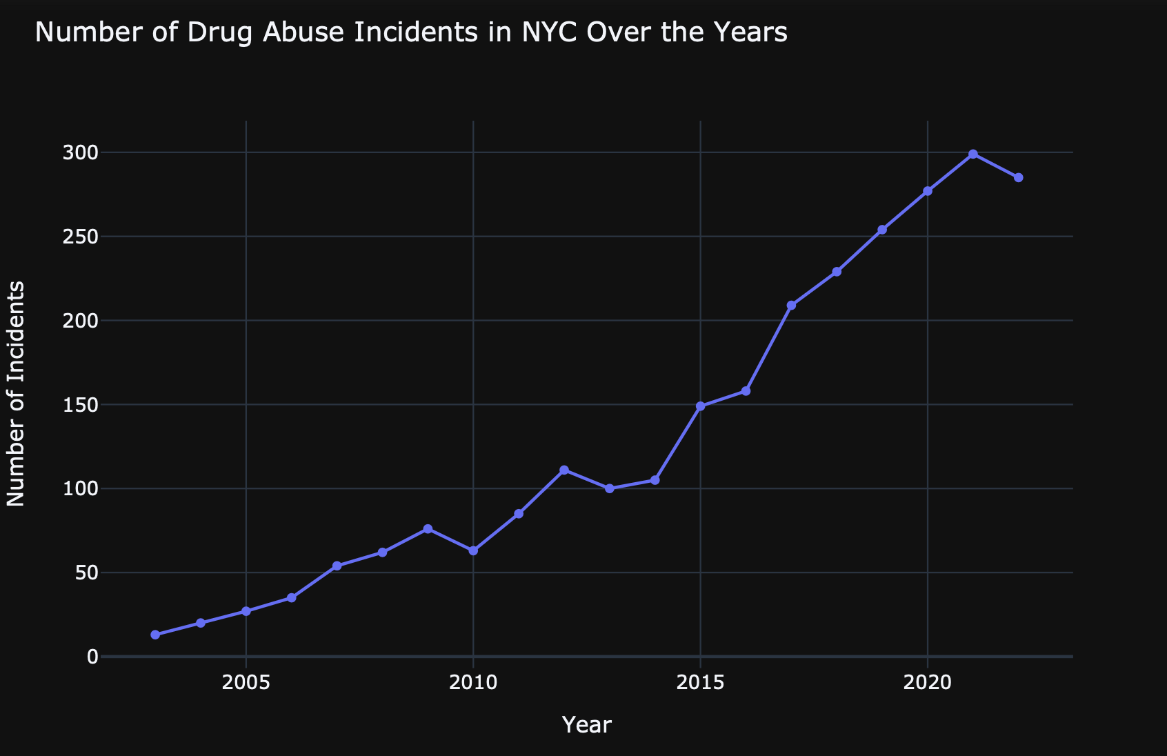
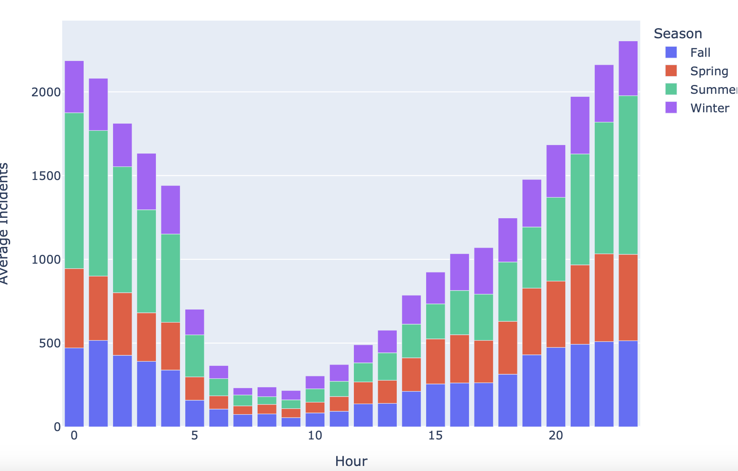
and we can do it!

Slide 20
Citations & References!
https://www.nycourts.gov/courts/nyc/drug_treatment/
https://www.schools.nyc.gov/school-life/special-situations/substance-abuse-prevention-
and-intervention
https://nypost.com/2019/12/02/heroin-use-jumps-33-among-nyc-teens-health-department/
https://drugabusestatistics.org/teen-drug-use/
https://www.ncbi.nlm.nih.gov/pmc/articles/PMC5525418/
https://www.ncbi.nlm.nih.gov/pmc/articles/PMC2681083/
https://www.samhsa.gov/data/sites/default/files/reports/rpt39443/2021NSDUHFFRRev01
0323.pdf
https://www.nyc.gov/assets/doh/downloads/pdf/survey/survey-2009drugod.pdf
https://www.nytimes.com/2021/11/30/nyregion/supervised-injection-sites-nyc.html
https://jamanetwork.com/journals/jamapediatrics/fullarticle/189961
https://americanaddictioncenters.org/

Slide 21
Last but not the least, Thank You ! Akanksha & Professor Rumi for the guidance, insights & help throughout the course!

Slide 22
Sai Nishanth Mettu Praneeth Kumar Thummalapalli Varad Naik

